Slide 1
Backtracking

Slide 2
CSP
Sometimes we can finish the constraint propagation process and still have variables with multiple possible values.
In that case we have to search for a solution.
For a CSP with n variables of domain size d we would end up with a search tree where all the complete assignments (and thus all the solutions) are leaf nodes at depth n. But notice that the branching factor at the top level would be nd because any of d values can be assigned to any of n variables.
At the next level, the branching factor is (n — 1)d, and so on for n levels.
So the tree has n!.d^{n} leaves, even though there are only d^{n} possible complete assignments!

Slide 3
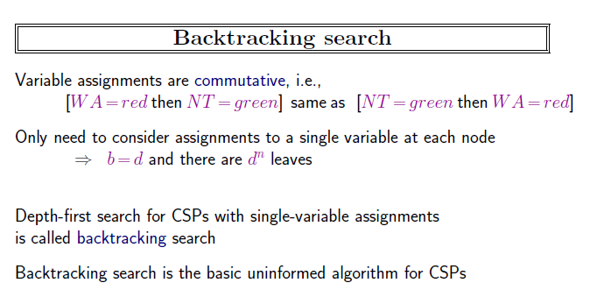

Slide 4
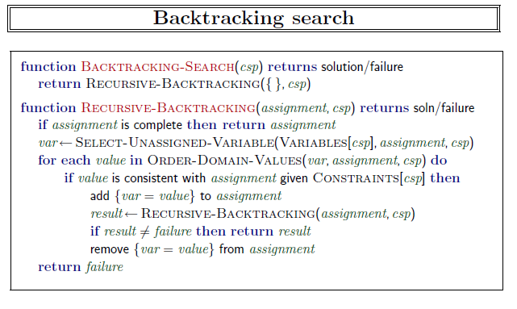
Notes:
It repeatedly chooses an unassigned variable, and then tries all values in the domain of that variable in turn, trying to extend each one into a solution via a recursive call. If the call succeeds, the solution is returned, and if it fails, the assignment is restored to the previous state, and we try the
next value. If no value works then we return failure.
Notice that BACKTRACKING-SEARCH keeps only a single representation of a state (assignment)
and alters that representation rather than creating new ones .

Slide 5
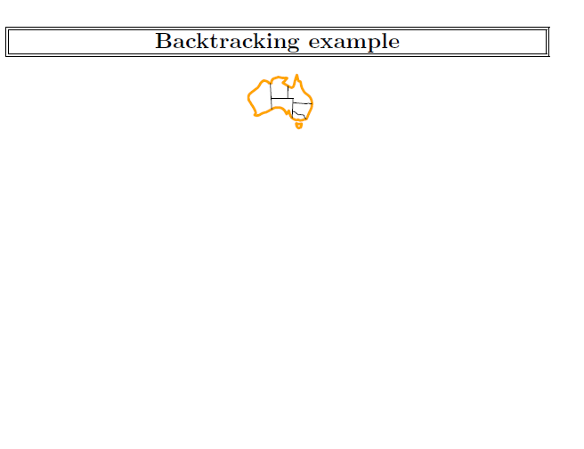

Slide 6
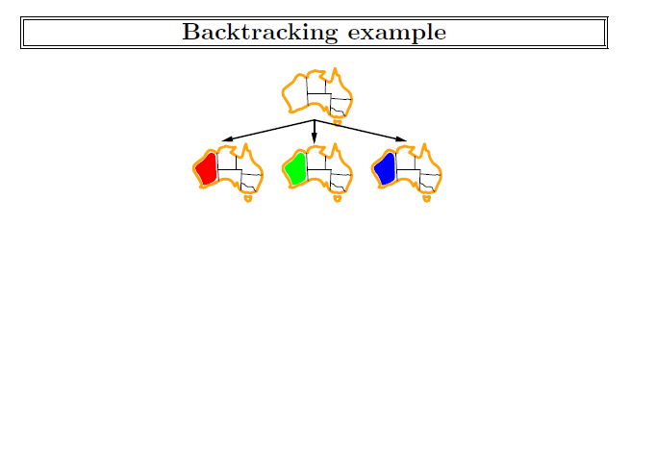

Slide 7
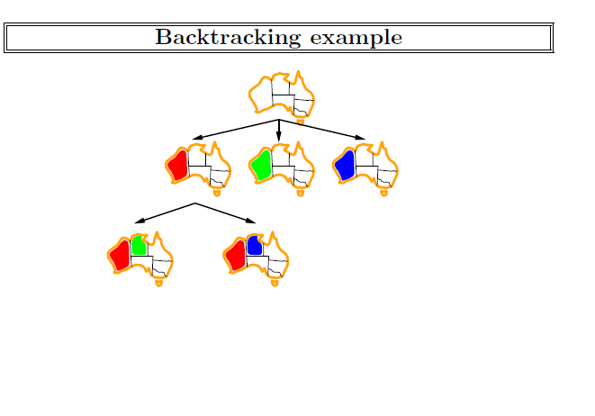

Slide 8
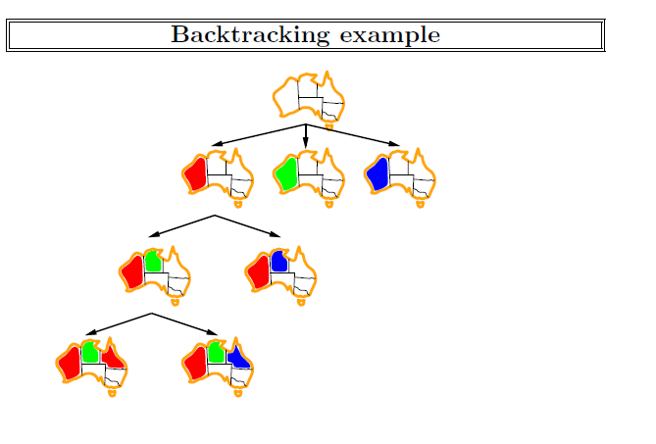

Slide 9
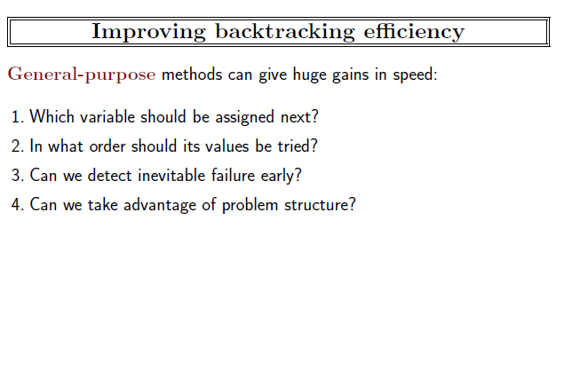
Notes:
* (6.3.1) Which variable should be assigned next (SELECT-UNASSIGNED-VARIABLE),
and in what order should its values be tried (ORDER-DOMAIN-VALUES)?
* (6.3.2) What inferences should be performed at each step in the search (INFERENCE)?
+ (6.3.3) Can we BACKTRACK more than one step when appropriate?
* (6.3.4) Can we save and reuse partial results from the search?

Slide 10
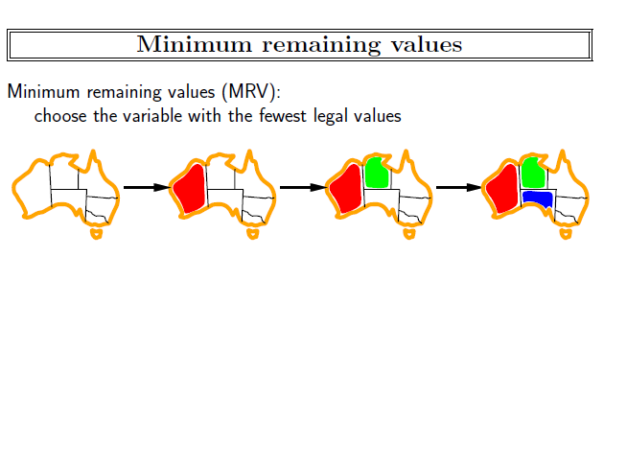
Notes:
choosing the variable with the fewest “legal” values—is called the
minimum-remaining-values (MRV) heuristic. It also has been called the “most constrained
variable™ or “fail-first” heuristic, the latter because it picks a variable that is most likely to
cause a failure soon, thereby pruning the search tree.
If some variable X has no legal values
left, the MRV heuristic will select X and failure will be detected immediately—avoiding
pointless searches through other variables.
For example, after the assignments for WA = red and NT = green in Figure 6.6,
there is only one possible value for SA, so it makes sense to assign SA = blue next rather than
assigning Q. In fact, after SA is assigned, the choices for Q, NSW, and V are all forced.

Slide 11
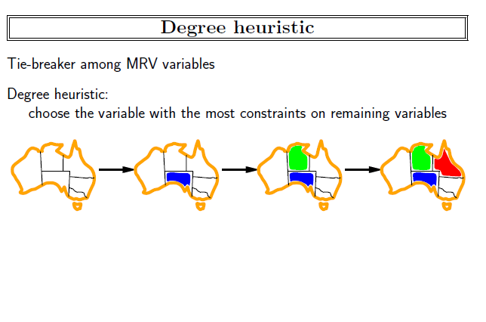
Notes:
The MRV heuristic doesn’t help at all in choosing the first region to color in Australia,
because initially every region has three legal colors. In this case, the degree heuristic comes
in handy. It attempts to reduce the branching factor on future choices by selecting the variable
that is involved in the largest number of constraints on other unassigned variables.
In Figure 6.1, SA is the variable with highest degree, 5; the other variables have degree 2 or 3, except
for T, which has degree 0. In fact, once SA is chosen, applying the degree heuristic solves the
problem without any false steps—you can choose any consistent color at each choice point
and still arrive at a solution with no backtracking.
The minimum-remaining-values heuristic
is usually a more powerful guide, but the degree heuristic can be useful as a tie-breaker.

Slide 12
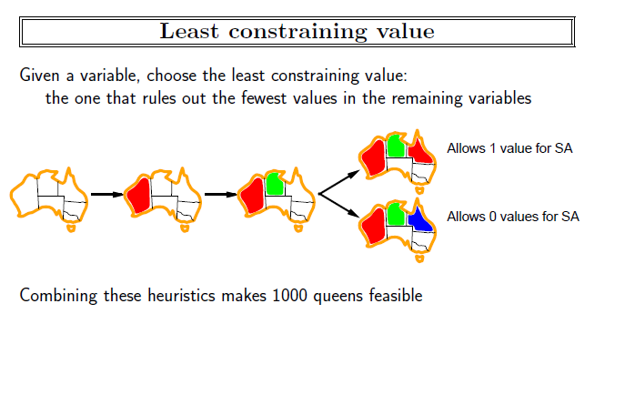
Notes:
Once a variable has been selected, the algorithm must decide on the order in which to
examine its values. The least-constraining-value heuristic is effective for this. It prefers
the value that rules out the fewest choices for the neighboring variables in the constraintgraph.
For example, suppose that in Figure 6.1 we have generated the partial assignment
with WA =r ed and NT= green and that our next choice is for Q. Blue would be a bad choice
because it eliminates the last legal value left for Q’s neighbor, SA. The least-constrainingvalue
heuristic therefore prefers red to blue. In general, the heuristic is trying to leave the
maximum flexibility for subsequent variable assignments.

Slide 13
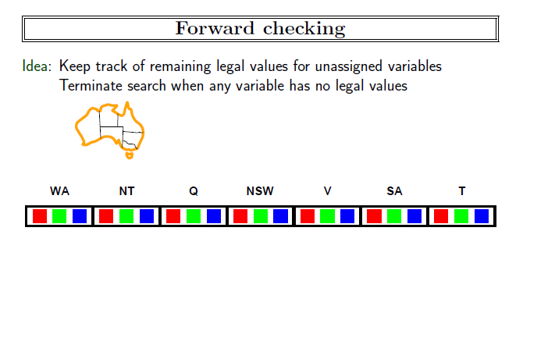

Slide 14
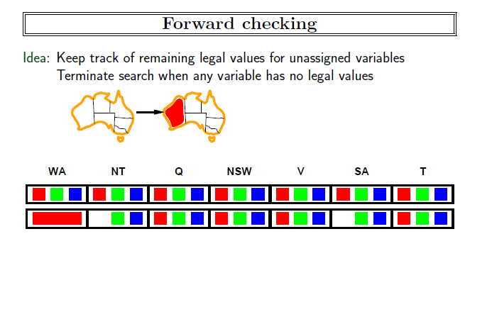

Slide 15
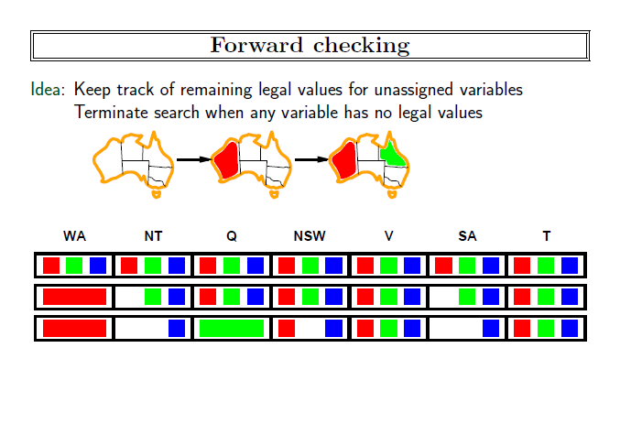

Slide 16
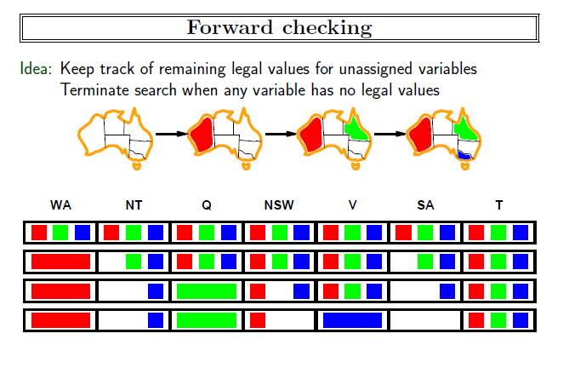

Slide 17
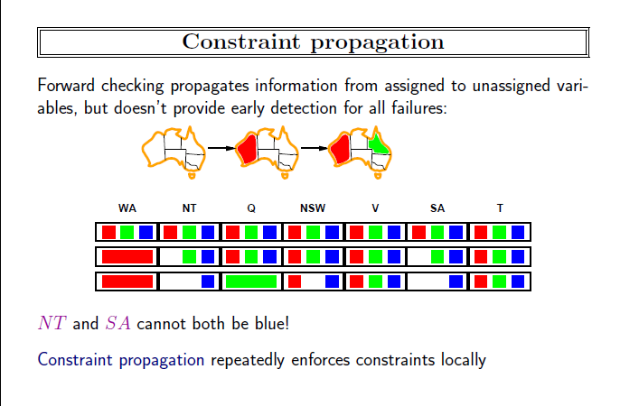

Slide 18
Arc-consistentency
A variable in a CSP is arc-consistent (edge-consistent) if every value in its domain satisfies the variable’s binary constraints.
Xi is arc-consistent with respect to another variable Xj; if for every value in the current domain Di there is some value in the domain Dj that satisfies the binary constraint on the arc (Xi,Xj).
A graph is arc-consistent if every variable is arcconsistent with every other variable.

Slide 19
Example
Consider the constraint Y = X²
where the domain of both X and Y is the set of decimal digits.
We can write this constraint explicitly as
((X,Y),{(0,0),(1,1),(2,4),(3,9)})
To make X arc-consistent with respect to Y,
we reduce X’s domain to {0, 1,2,3}.
If we also make Y arc-consistent with respect to X,
then Y’s domain becomes {0, 1,4,9}, and the whole CSP is arc-consistent.

Slide 20
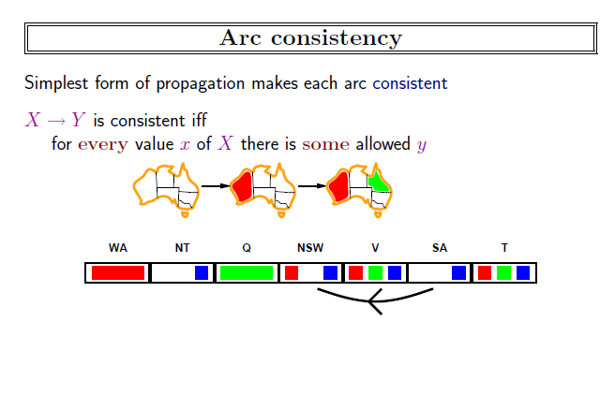

Slide 21
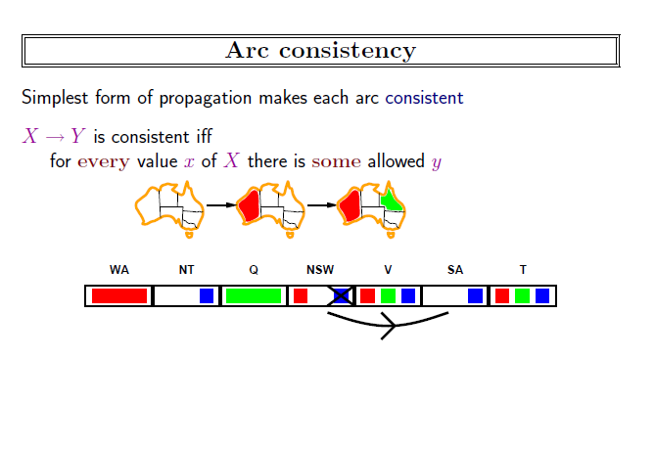

Slide 22
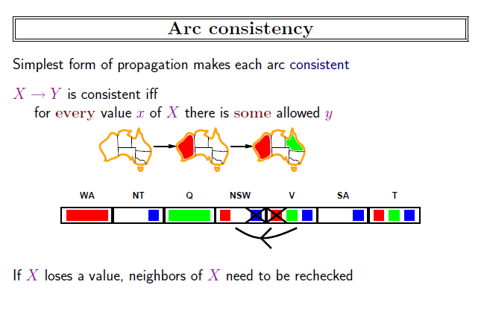

Slide 23
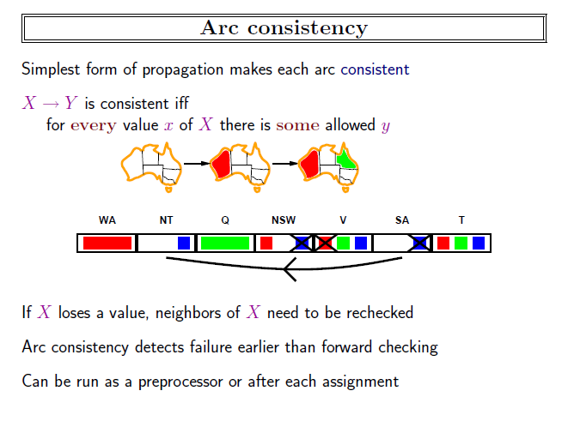

Slide 24
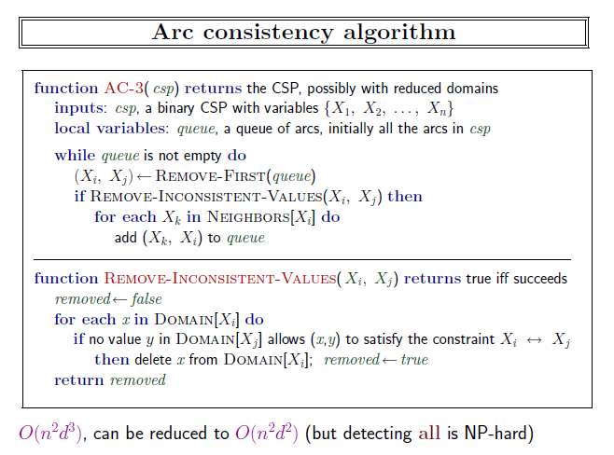

Slide 25
AC-3 algorithm
We can represent the AC-3 algorithm in 3 steps:
Get all the constraints and turn each one into two arcs. For example: 𝐴 > 𝐵 becomes 𝐴 > 𝐵 and 𝐵 < 𝐴.
Add all the arcs to a queue.
Repeat until the queue is empty: 3.1. Take the first arc (𝑥, 𝑦), off the queue (dequeue). 3.2. For every value in the 𝑥 domain, there must be some value of the 𝑦 domain. 3.3. Make 𝑥 arc consistent with 𝑦. To do so, remove values from 𝑥 domain for which there is no possible corresponding value for 𝑦 domain. 3.4. If the 𝑥 domain has changed, add all arcs of the form (𝑘, 𝑥) to the queue (enqueue). Here 𝑘 is another variable different from 𝑦 that has a relation to 𝑥.

Slide 26
Example
Let’s take this example, where we have three variables 𝐴, 𝐵, and 𝐶 and the constraints: 𝐴 > 𝐵 and 𝐵 = 𝐶.
A={1,2,3}
B={1,2,3}
C={1,2,3}

Slide 27
Step 1: Generate All Arcs
A>B
B<A
B=C
C=B

Slide 28
Step 2: Create the Queue
Arcs
Queue:
A>B
B<A
B=C
C=B
A>B
B<A
B=C
C=B

Slide 29
Step 3: Iterate Over the Queue
Arcs
Queue:
A={1,2,3}
B={1,2,3}
C={1,2,3}
A>B
B<A
B=C
C=B
A>B
B<A
B=C
C=B

Slide 30
Step 3: Iterate Over the Queue
Arcs
Queue:
A>B
B<A
B=C
C=B
A>B
B<A
B=C
C=B
A={2,3}
B={1,2,3}
C={1,2,3}

Slide 31
Step 3: Iterate Over the Queue
Arcs
Queue:
A>B
B<A
B=C
C=B
A>B
B<A
B=C
C=B
A={2,3}
B={1,2,3}
C={1,2,3}

Slide 32
Step 3: Iterate Over the Queue
Arcs
Queue:
A>B
B<A
B=C
C=B
A>B
B<A
B=C
C=B
A>B
A={2,3}
B={1,2}
C={1,2,3}

Slide 33
Step 3: Iterate Over the Queue
Arcs
Queue:
A>B
B<A
B=C
C=B
A>B
B<A
B=C
C=B
A>B
A={2,3}
B={1,2}
C={1,2,3}

Slide 34
Step 3: Iterate Over the Queue
Arcs
Queue:
A>B
B<A
B=C
C=B
A>B
B<A
B=C
C=B
A>B
A={2,3}
B={1,2}
C={1,2,3}

Slide 35
Step 3: Iterate Over the Queue
Arcs
Queue:
A>B
B<A
B=C
C=B
A>B
B<A
B=C
C=B
A>B
A={2,3}
B={1,2}
C={1,2,3}

Slide 36
Step 3: Iterate Over the Queue
Arcs
Queue:
A>B
B<A
B=C
C=B
A>B
B<A
B=C
C=B
A>B
A={2,3}
B={1,2}
C={1,2}

Slide 37
Step 3: Iterate Over the Queue
Arcs
Queue:
A>B
B<A
B=C
C=B
A>B
B=C
A>B
B<A
B=C
C=B
A={2,3}
B={1,2}
C={1,2}

Slide 38
Step 3: Iterate Over the Queue
Arcs
Queue:
A>B
B<A
B=C
C=B
A>B
B=C
A>B
B<A
B=C
C=B
A={2,3}
B={1,2}
C={1,2}

Slide 39
Step 3: Iterate Over the Queue
Arcs
Queue:
A>B
B<A
B=C
C=B
A>B
B=C
A>B
B<A
B=C
C=B
A={2,3}
B={1,2}
C={1,2}

Slide 40
Step 4: Stop if no more arc in the queue
Arcs
Queue:
A>B
B<A
B=C
C=B
A>B
B=C
A>B
B<A
B=C
C=B
A={2,3}
B={1,2}
C={1,2}

Slide 42
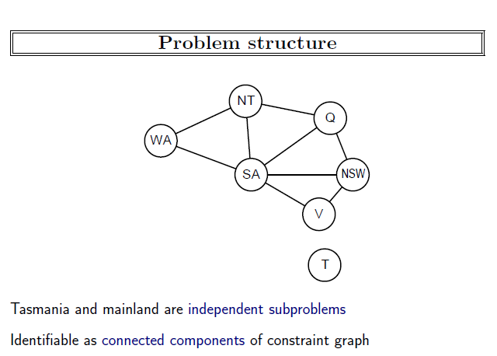

Slide 43
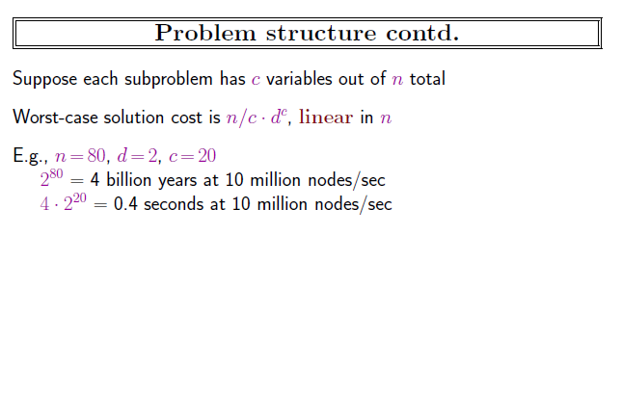

Slide 44
A Constraint graph is a tree when any two variables are connected by only one path.
We will show that any tree-structure CSP can be solved in time linear in the number of variables.
The key is a new notion of consistency, called directional arc consistency or DAC.
A CSP is defined to be directional arc-consistent under an ordering of variables X1,X2,...,Xn, if and only if every Xi is arc consistent with each Xj for j > i.

Slide 45
To solve a tree-structured CSP, first pick any variable to be the root of the tree, and choose an ordering of the variables such that each variable appears after its parent in the tree.
Such an ordering is called a topological sort.

Slide 46
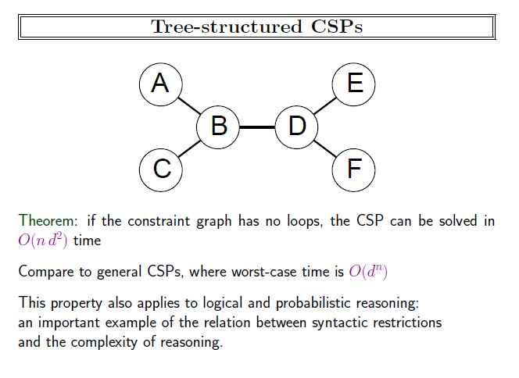

Slide 47
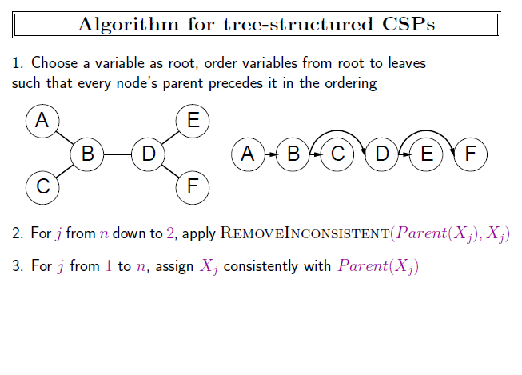

Slide 48
Once we have a directed arc-consistent graph, we can just march down the list of variables and choose any remaining value.
Since each edge from a parent to its child is arc-consistent, we know that for any value we choose for the parent, there will be a valid value left to choose for the child.
That means we won’t have to backtrack; we can move linearly through the variables.

Slide 49
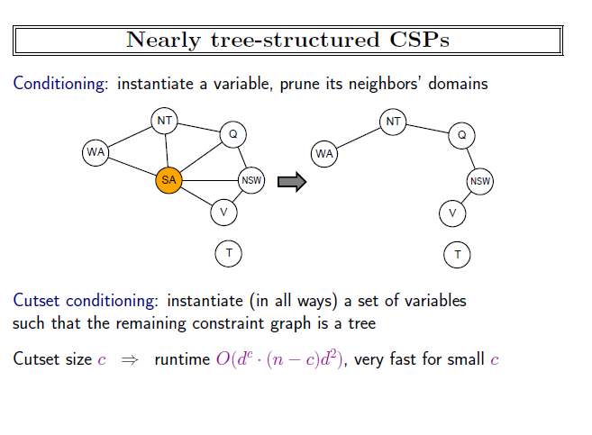

Slide 50
Cycle Cutset Algorithm
Choose a subset S of the CSP’s variables such that the constraint graph becomes a tree after removal of S. is called a cycle cutset.
2. For each possible assignment to the variables in S that satisfies all constraints on S,
remove from the domains of the remaining variables any values that are inconsistent with the assignment for S, and
(b) if the remaining CSP has a solution, return it together with the assignment for S

Slide 51
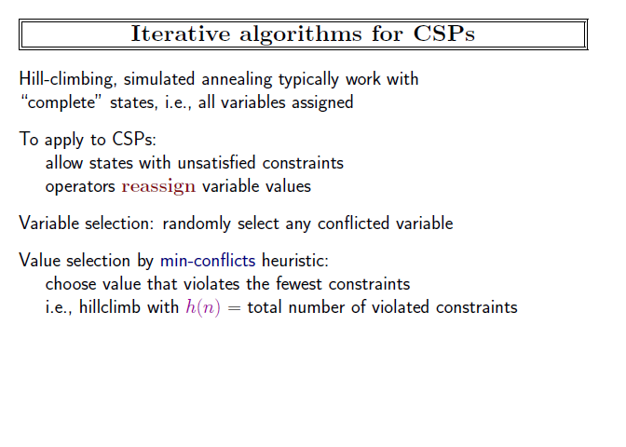

Slide 52
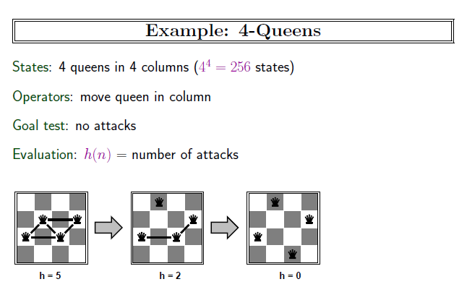

Slide 53
